Slide 1

CRISA MARKETING RESEARCH SEGMENTATION of BATH SOAP COSUMERS
Presented by
Rakhee Moolchandani

Slide 2
CURRENT STATE
FUTURE PLANS
Demographics
Social Economic class
Eating Habits
Native Language
Gender
Age
Education Level
Members in House
No. of Children
Availability of Television
Affluence Index
Purchase Behavior
Brand Loyalty
Transactions
Offers and Discounts
Basis of Purchase
Price
Propositions

Slide 3
TARGET CONSUMERS
Women aging 35 years and above
3-5 members in a household
Children ages 7 and up
Watch Television
Segment #2
Purchase higher volumes of average price popular soaps.
Segment #1
Higher Socioeconomic Level, Education & Affluence Index
Purchase smaller volumes of high price premium soaps.
Segment #3
Low Socioeconomic Level, Education & Affluence Index
Average Socioeconomic Level, Education & Affluence Index
Less likely to purchase during promotional period.
More likely to purchase during promotional period.
Purchase less volumes of low-price economy soaps.
Most likely to purchase during promotional period.
Most Loyal Customers
Least Loyalty
Less Brand loyalty

Slide 4
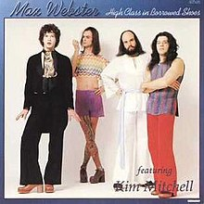
RECOMMENDATION
Separate Promotion Campaigns targeting:
High Social level and Educated class.
Low Social level and Educated class.
This Photo by Unknown Author is licensed under CC BY-SA

Slide 5
Thank You!
Kent.edu

